Slide 1
Handwritten Digit Generation using GANs
A presentation on the intricate workings of GANs in generating realistic handwritten digits and their potential in various applications.
-Yathindra Pravanan TV
-311521104063

Slide 2
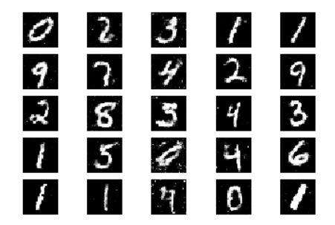
Handwritten Digit Generation using GANs
Introduction
GAN Architecture
Handwritten Digit Generation
Code Overview
Training Process
Understanding GAN
Challenges and Limitation
Applications and Future Scope
Conclusion

Slide 3
Introduction
Objective: Exploring the power of Generative Adversarial Networks (GANs) in generating realistic handwritten digit images.
Background: Handwritten digit generation plays a crucial role in various applications such as digit recognition systems, document analysis, and synthetic data generation for machine learning.
Approach: Leveraging GANs, a cutting-edge deep learning technique, to generate synthetic handwritten digits that closely resemble real-world examples.
Agenda: In this presentation, we'll delve into the architecture of GANs, discuss the training process, showcase the results of generating handwritten digits, and explore future directions for this exciting field.

Slide 4
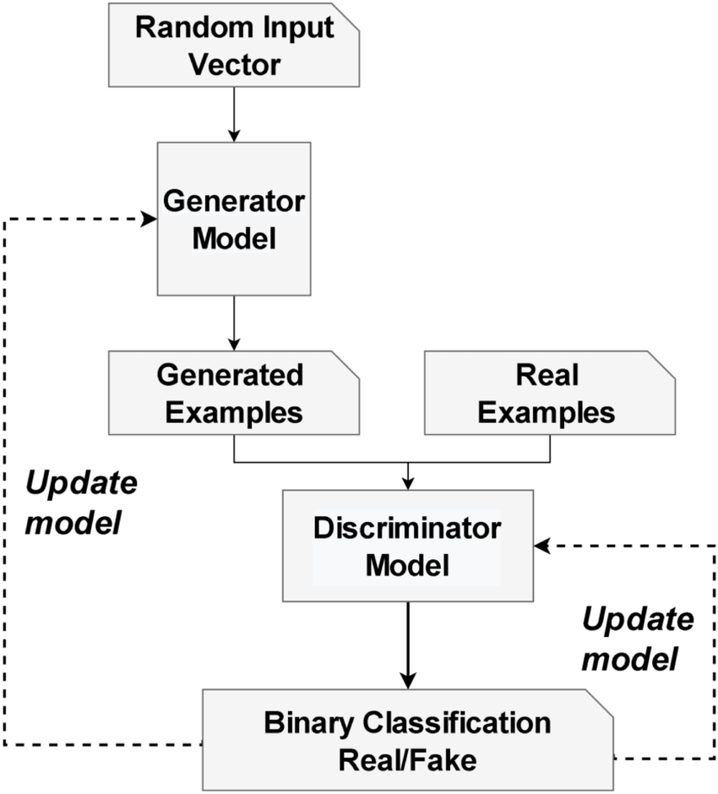
GAN Architecture
The GAN architecture consists of a Generator network, which generates synthetic data, and a Discriminator network, which distinguishes between real and synthetic data. During training, the Generator learns to produce data that is increasingly indistinguishable from real examples, while the Discriminator learns to better classify between real and synthetic data. This adversarial process leads to the generation of high-quality synthetic data that closely resembles real data examples.

Slide 5
Handwritten Digit Generation

Slide 6
Handwritten Digit Generation
Generator Model:
Input:
Random noise vector (latent space) sampled from a Gaussian distribution. This vector serves as the seed for generating digits.
Architecture:
Fully connected layers: The noise vector is passed through several fully connected layers, gradually increasing the spatial dimensions.
ReLU activation function: Applied after each fully connected layer to introduce non-linearity.
Output layer: Utilizes a sigmoid activation function to squash the values to the range [0, 1], representing grayscale pixel values.
Output:
A 28x28 grayscale image representing a handwritten digit.

Slide 7
Discriminator Model:
Input:
Either a real handwritten digit image or a synthetic image generated by the Generator.
Architecture:
Convolutional layers: Process the input image, extracting features through convolutions.
Leaky ReLU activation function: Applied after each convolutional layer to introduce non-linearity.
Fully connected layers: Flatten the output from the convolutional layers and pass it through fully connected layers for binary classification.
Output layer: Utilizes a sigmoid activation function to produce a probability indicating whether the input image is real or fake.

Slide 8
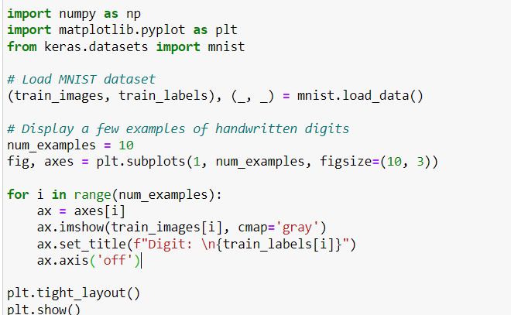
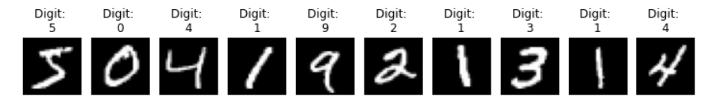
Code Overview

Slide 9
Training Process
Generator Training:
The Generator takes random noise as input and generates synthetic images.
These synthetic images are then fed into the Discriminator.
The Generator aims to generate images that the Discriminator classifies as real.
Discriminator Training:
The Discriminator is trained on both real images from the MNIST dataset and synthetic images from the Generator.
It learns to distinguish between real and synthetic images.
The Discriminator provides feedback to the Generator, guiding it to produce more realistic images.

Slide 10
Evaluation:
Quality Metrics:
Metrics such as Frechet Inception Distance (FID) or Inception Score (IS) can be used to evaluate the quality and diversity of the generated images.
Visual Inspection:
Generated images can be visually inspected to assess their quality, clarity, and resemblance to real handwritten digits.

Slide 11
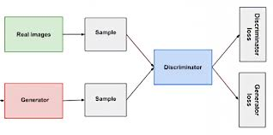
Understanding GAN
Understanding Generative Adversarial Networks (GANs) is crucial in grasping the dynamics behind generating realistic data. Introduced by Ian Goodfellow and his team in 2014, GANs have revolutionized generative modeling, attracting widespread attention for their ability to create highly convincing data samples. At its core, a GAN consists of two neural networks: the generator and the discriminator. The generator's role is to produce synthetic data samples, while the discriminator aims to distinguish between real and fake data. Through an adversarial training process, these networks engage in a game-like scenario where the generator strives to generate data indistinguishable from genuine samples, while the discriminator seeks to accurately differentiate between real and fake data. This interplay leads to the refinement of both networks over time, ultimately resulting in the generation of high-quality synthetic data.

Slide 12
Challenges and Limitations
Future directions for research and development
Future GAN research focuses on stability, mode collapse, novel architectures, ethical concerns, interdisciplinary collaboration, and expanding applications across domains.
Mode collapse and overfitting in GANs
Mode collapse in GANs: limited diversity in generated samples. Overfitting: generator fails to capture full data distribution, reducing model efficacy.
Strategies for mitigating challenges
Strategies for mitigating challenges in GANs include architectural modifications, regularization techniques, diverse training data, and novel loss functions.

Slide 13
Applications and Future Scope
Applications and Future Scope of Generative Adversarial Networks (GANs) span a wide array of fields, promising transformative impacts on various industries and research domains. GANs have already demonstrated their versatility and potential in numerous applications, and their future scope continues to expand as researchers explore novel use cases and address existing challenges.
In the realm of computer vision, GANs have revolutionized image generation, enabling the creation of photorealistic images from textual descriptions or sketches. This capability has profound implications for industries such as advertising, entertainment, and fashion, where high-quality visual content is paramount. GANs are also employed in image-to-image translation tasks, facilitating tasks like style transfer, image super-resolution, and domain adaptation.
Looking ahead, the future scope of GANs holds tremendous potential for further innovation and advancement. Research efforts are focused on addressing challenges such as training stability, mode collapse, and ethical considerations surrounding the generation of synthetic data. Novel architectures, training techniques, and applications of GANs are continuously being explored, paving the way for advancements in areas such as:
3D object generation and manipulation
Audio synthesis and music composition
Robotics and autonomous systems
Personalized content generation
Environmental simulation and climate modeling.

Slide 14
Conclusion
In conclusion, Generative Adversarial Networks (GANs) represent a groundbreaking advancement in the field of artificial intelligence, offering unparalleled capabilities in generating realistic data across various domains. From computer vision to natural language processing and beyond, GANs have demonstrated their versatility and potential in a myriad of applications, revolutionizing industries and driving innovation. Through an adversarial training paradigm, GANs enable the creation of lifelike images, texts, and other data types, with implications ranging from entertainment and healthcare to education and beyond.
In essence, Generative Adversarial Networks represent not just a technological advancement, but a paradigm shift in how we interact with and utilize artificial intelligence. With continued research, collaboration, and exploration, the potential of GANs is limitless, offering boundless opportunities for discovery, creativity, and progress. As we embark on this journey, let us embrace the power of GANs to imagine, create, and innovate, shaping a future where artificial intelligence enriches and enhances every aspect of our lives.

Slide 15
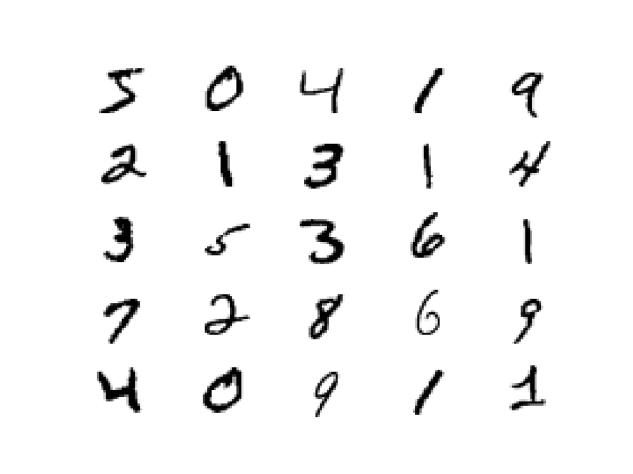
Thank you!!

